Slide 1
LAB III

Slide 2

Cassandra Client APIs
Thrift RPC Based API
Cassandra-cli : for DDL , DML and data exploration
CQL: syntax based on SQL. No support for JOINs. Will be the future client API
Java: Hector API
Recent versions of hector use CQL
Connection pooling , failover , jmx

Slide 3
Cassandra Client APIs
Java : Astyanax from netflix
Object Oriented interface to cassandra
Complete encapsulation of the underlying Thrift API and structs.
Python: Pycassa Client API
Connection Pooling
PHP : PHPCassa client api
Connection Pooling , method for Counting Rows

Slide 4
Hector API
High level, simple object oriented interface to Cassandra
Failover behavior on the client side
connection pooling for improved performance and scalability
JMX counters for monitoring and management
Configurable and extensible load balancing (round robin (the default), least active, and a phi-accrural style response time detector)
Complete encapsulation of the underlying Thrift API and structs
Automatic retry of downed hosts
Automatic discovery of additional hosts in the cluster
Suspension of hosts for a short period of time after several timeouts
Simple ORM layer that works
A type-safe approach to dealing with Apache Cassandra’s data model

Slide 5
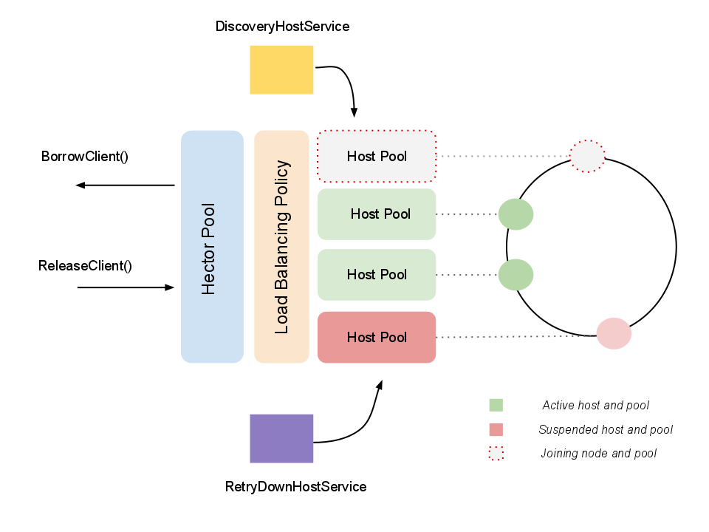
Hector Connection Pooling
Hector manages a pool of the connection pools towards Cassandra nodes

Slide 6


Hector Insert and Query Demo

Slide 7
Batch Insertion
Hector can batch records for insertion saving database hits

Slide 8
Kundera
To make working with NoSQL as simple as working with SQL
To serve as JPA Compliant mapping solution for NoSQL Datastores.
To help developers, forget the complexity of NoSQL stores and focus on Domain Model.
To make switching across data-stores as easy as changing a configuration.

Slide 9
Kundera : Supported Datasources
Cassandra
MongoDB
HBase
Redis
OracleNoSQL
Neo4j
Relational databases

Slide 10
Kundera Spring
Spring supports JPA and Kundera is built on top of JPA, this combination works smooth and seamlessly

Slide 11
Kundera Spring Cassandra Demo

